Slide 1
Data-driven insights on car pricing, fuel type, and cost efficiency Based on company HR data (2024–2025)
Presented by Shreya Guha Data Entry Executive Date: September 2025

Slide 2
Project Objective
Purpose:
Analyze car sales data to understand pricing, mileage, and efficiency trends.
Compare manufacturers, engine categories, and fuel types.
Develop an interactive Excel dashboard to visualize key performance metrics.
Tools Used:
Excel (Pivot Tables, Charts, Slicers, Conditional Formatting, KPIs).

Slide 3
Dataset Overview
Source: Kaggle – Mock Dataset of Car Sales
Key Fields:
Manufacturer, Model, Engine Size, Engine Category
Fuel Type, Year of Manufacture, Car Age, Age Category
Mileage, Price, Cost Efficiency (Price /Mileage)
Structure:
4 Worksheets → Raw Data | Pivot Analysis | Visuals | Dashboard

Slide 4
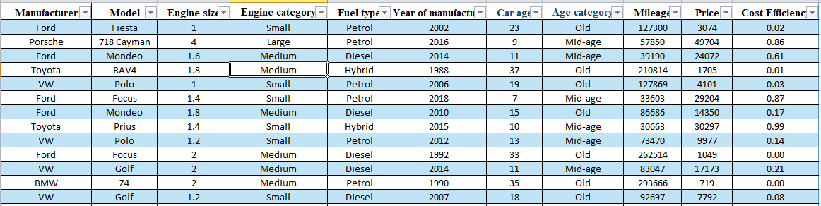
Sample of Raw Data Table
Figure: Sample rows from the raw data used for car sales analysis.

Slide 5
KPIs / Summary Metrics
Main Indicators (from Dashboard):
Total Cars: 50,000
Average Car Price: ₹13,828.90
Fuel Types: 3
Oldest Car Age: 41 years
Average Mileage: 112,497.32 km
Average Cost Efficiency: 0.49
Most Common Manufacturer: Ford

Slide 6
Key Visuals

Slide 7
Pricing Patterns and Fuel Distribution

Slide 8
Observation: Highlights premium vs. affordable brands. Porsche and BMW represent the premium segment, while Ford and VW fall under the affordable range.

Slide 9
Observation: Petrol cars dominate the dataset (~50%), while hybrids are rising.

Slide 10
Cost Efficiency Analysis

Slide 11
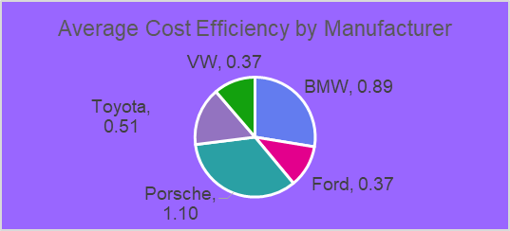
Observation: VW and Ford shows strong cost efficiency among mass brands.

Slide 12
Price vs. Efficiency Relationship

Slide 13
Observation: The scatter plot shows that higher car prices don’t necessarily imply better cost efficiency. BMW achieves the best efficiency despite premium pricing, while Porsche remains the least cost-effective. Ford, VW, and Toyota balance affordability with moderate efficiency.

Slide 14
Conclusion & Key Insights

Slide 15
01
02
03
04
Price and brand positioning
Fuel trend
Efficiency insight
Overall pattern
Luxury doesn’t always mean efficiency — BMW delivers premium cars with better cost efficiency, whereas Porsche trades off efficiency for performance.
Mid-priced brands (Toyota, Ford) offer a strong balance between affordability and operating cost.
Petrol remains the most common, but hybrids are gaining market share.
Porsche and BMW dominate the premium range, while Ford and VW cater to value-conscious buyers.
Final takeaway:
Data shows that cost efficiency and affordability, not just brand prestige, drive real-world value in the car market. Manufacturers focusing on balanced pricing and mileage efficiency hold the strongest long-term appeal.

Slide 16
Project Summary & Insights

Slide 17
Key Findings
50,000 car records analyzed across 5 major manufacturers.
Porsche and BMW dominate premium pricing; Ford and VW remain affordable.
Petrol cars are most common, but diesel and hybrids offer better efficiency.
Medium engine cars balance performance and cost efficiency well.
Price doesn’t directly correlate with cost efficiency — affordability can still mean smart design.

Slide 18
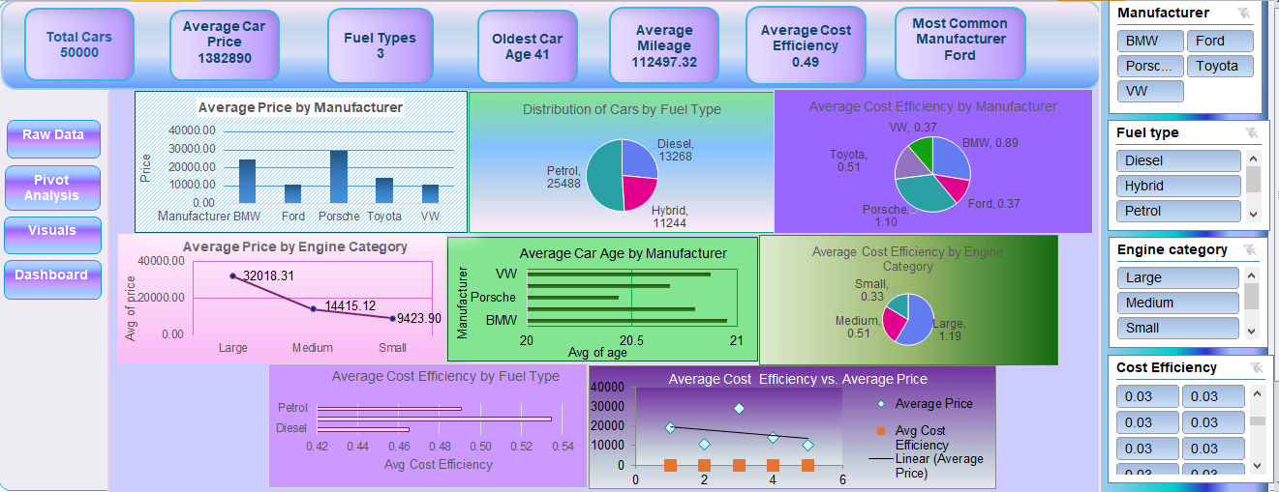
Dashboard Highlights
8 dynamic visuals showing price, efficiency, and engine trends.
Slicers for Manufacturer, Fuel Type, and Engine Category.
KPIs summarize the market: Avg Price ₹13,828.90 | Avg Efficiency 0.49.
Insights enable quick comparison of brands and highlight market positioning across fuel and engine types.
Ideal for automotive pricing strategy, cost optimization, and efficiency benchmarking.
Excel Dashboard: Data-driven view of manufacturer pricing, efficiency metrics, and overall car market trends.

Slide 19
Interactive Dashboard: Car Sales Analysis (Excel-Linked)

Slide 20
Click to explore live slicers and visuals in Excel

Slide 21
Recommendations (Based on Analysis)

Slide 22
3. For Marketing Teams
1. For Manufacturers
2. For Dealers
4. For Future Analysis
Focus on improving cost efficiency in mid-range cars to appeal to value-driven customers.
Promote efficiency metrics over luxury branding to attract practical buyers.
Highlight Toyota and Ford models as strong balance options between price and mileage.
Integrate EV data to track how electric cars shift cost-efficiency patterns.

Slide 23
Thank You

